Slide 1
GEM 2.0
Logo Relevance - Akhil and Tarun

Slide 2
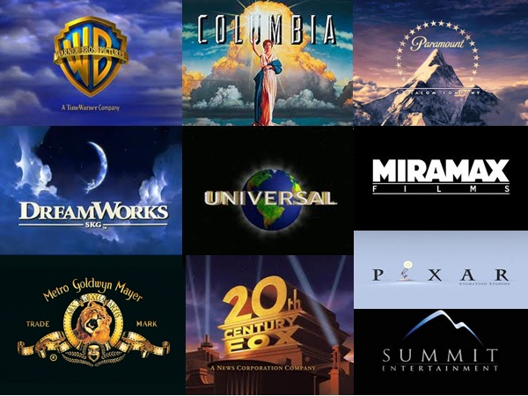
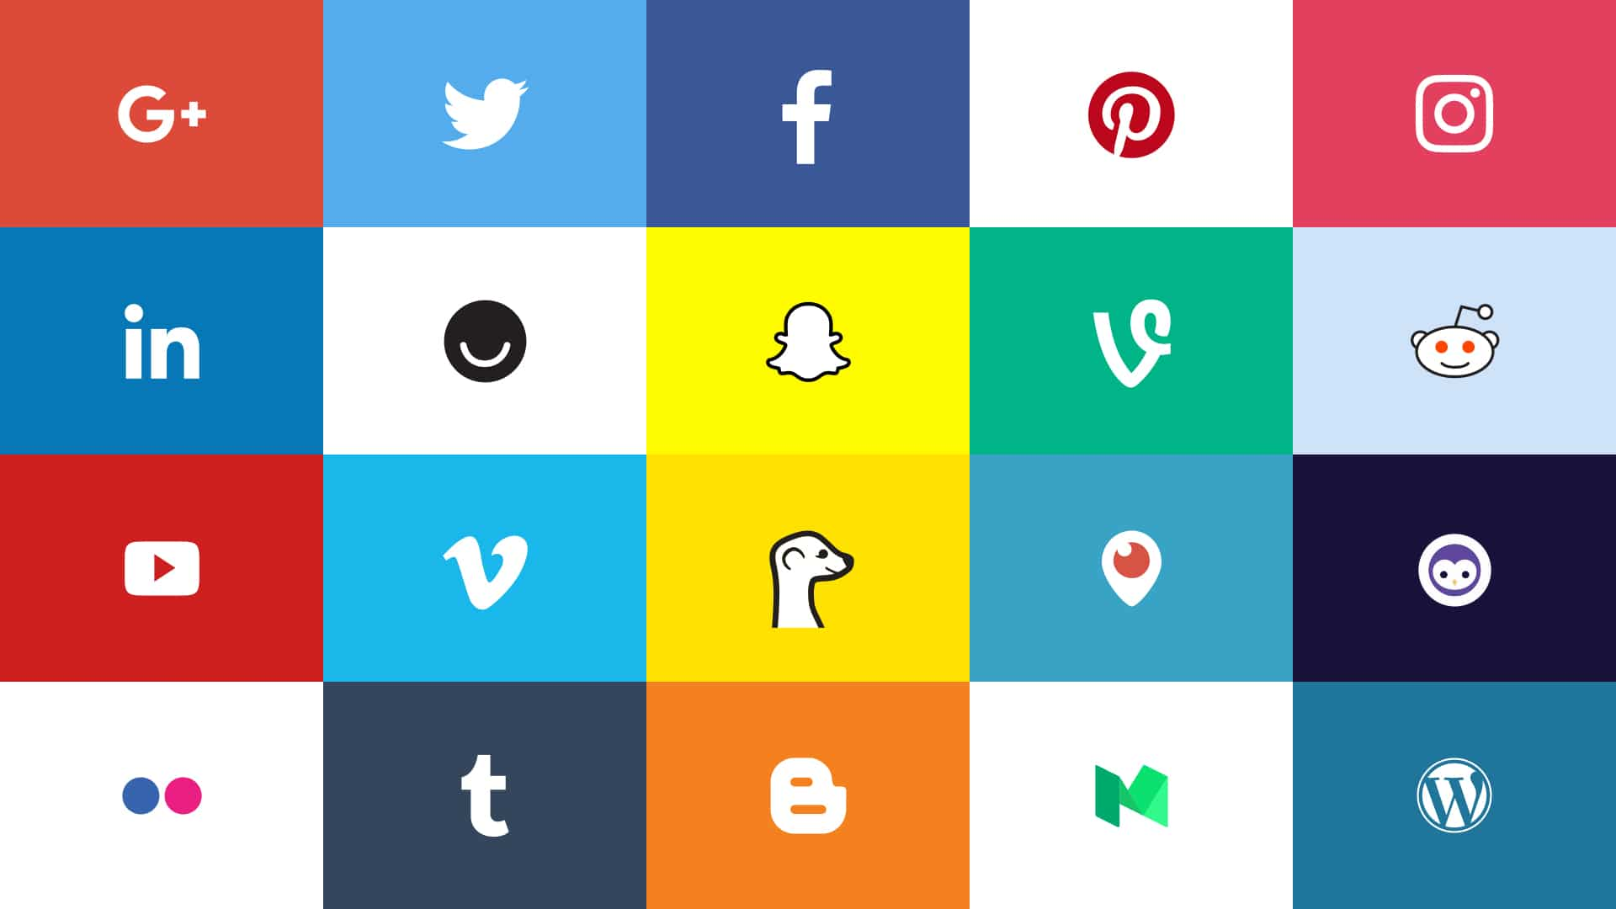
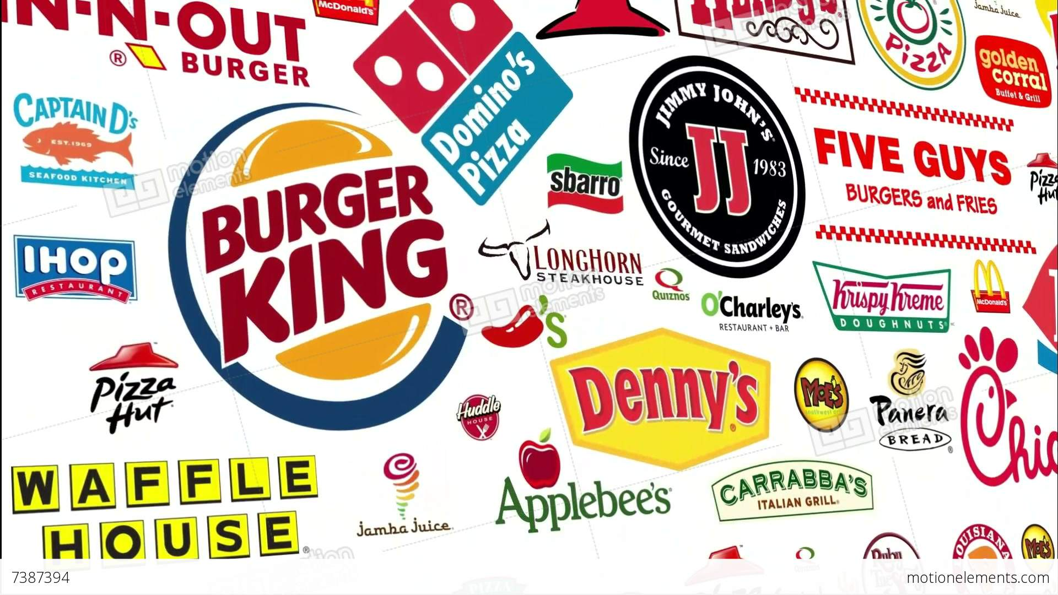
Background - Logo
Logo is the visual entity signifying an organization
As soon as you begin advertising your product with your logo, your logo is technically trademarked in the eyes of the law.
In the United States, trademark rights begin when the trademark is put into commercial use.

Slide 3
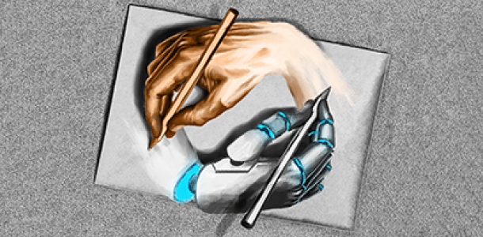
Abstract
The designer is always put to challenge to design a logo for a new organization that represents the organization's value/mission/nature of service they provide.
If he/she designs a logo, can we automatically pull out logos that match the one that is designed or is unique.
This reduces a lot of rework for the designers.

Slide 4
Applications
Logo Detection - (Finding all the logos in a video/image (opencv))
Making sure new logos are not similar to existing ones
Feature Extraction to generate new unique logos
Making commercial use of scraped logos (Manual selection required)
State of art classification - 500 classes (80%+ Accuracy)

Slide 5
Methodology
Data Gathering: Gather the images
Preprocessing: Clean and resize the images, Remove noise
Modelling: Extract the features, Classify the features
Evaluating: Select the similar logo(s), Rank the brand/logos
Deployment: API for similar logo recognition

Slide 6
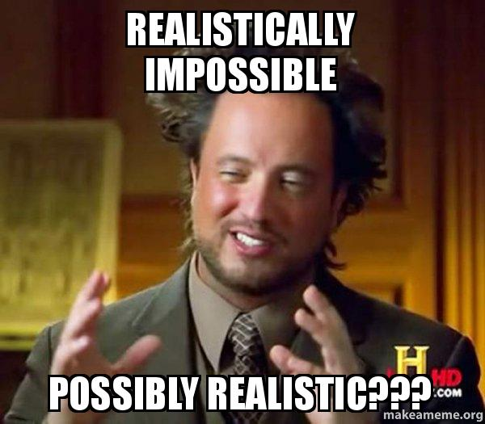
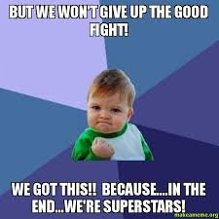
Ideal Data Required
Get the logos of all the existing companies
If not all, atleast for the top companies across the globe
Few hundreds of logos for each company

Slide 7
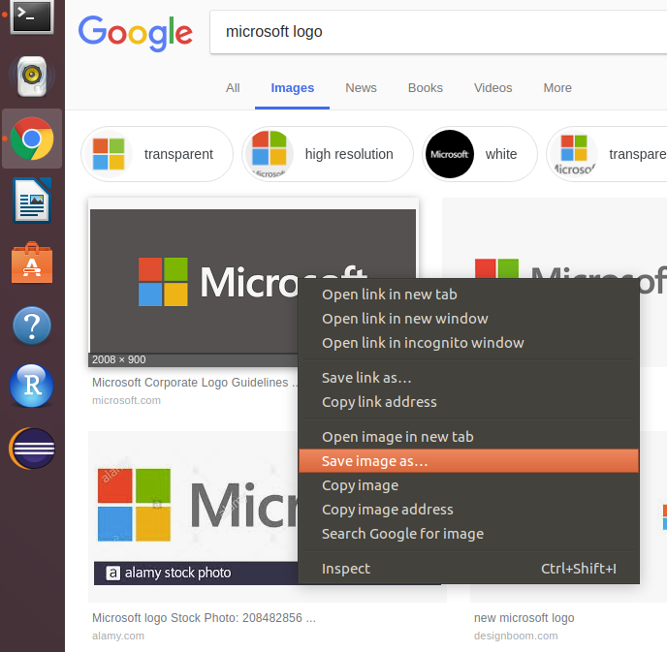

Data Gathering
Manually gathered Fortune 500 and Forbes 300 listed companies
Listed out top 500 companies from the above list
Planned to download 100 logos for each company
Should I do it manually like this?

Slide 8
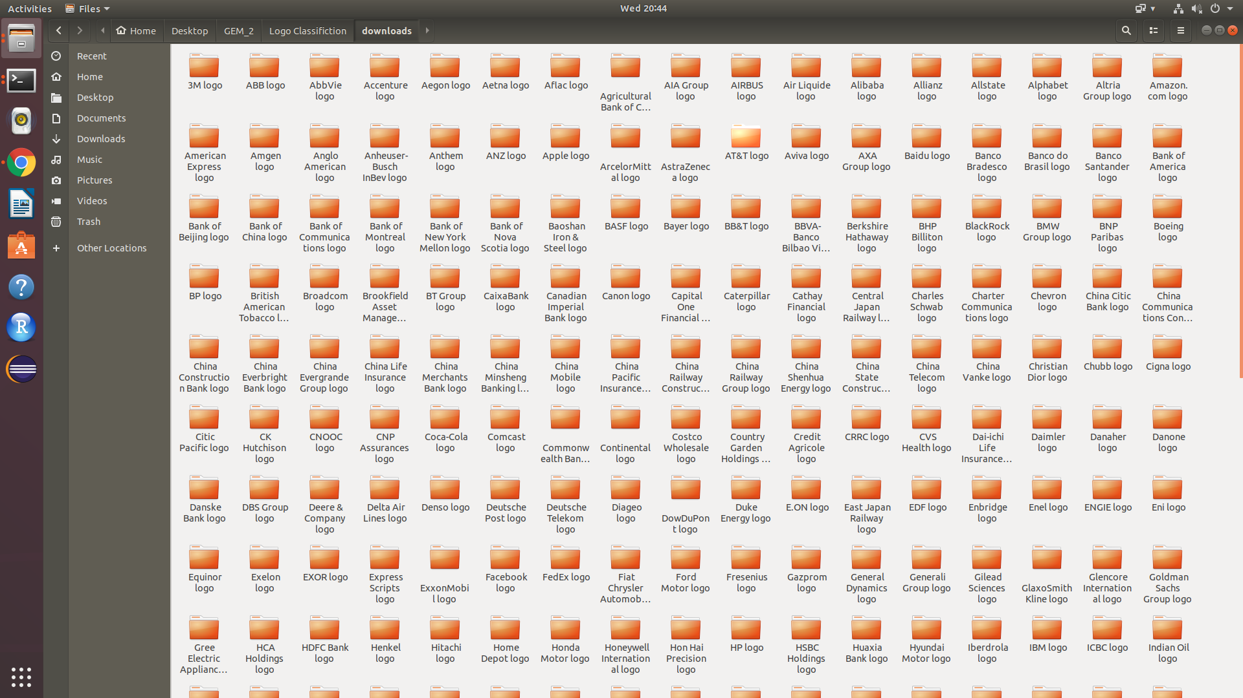
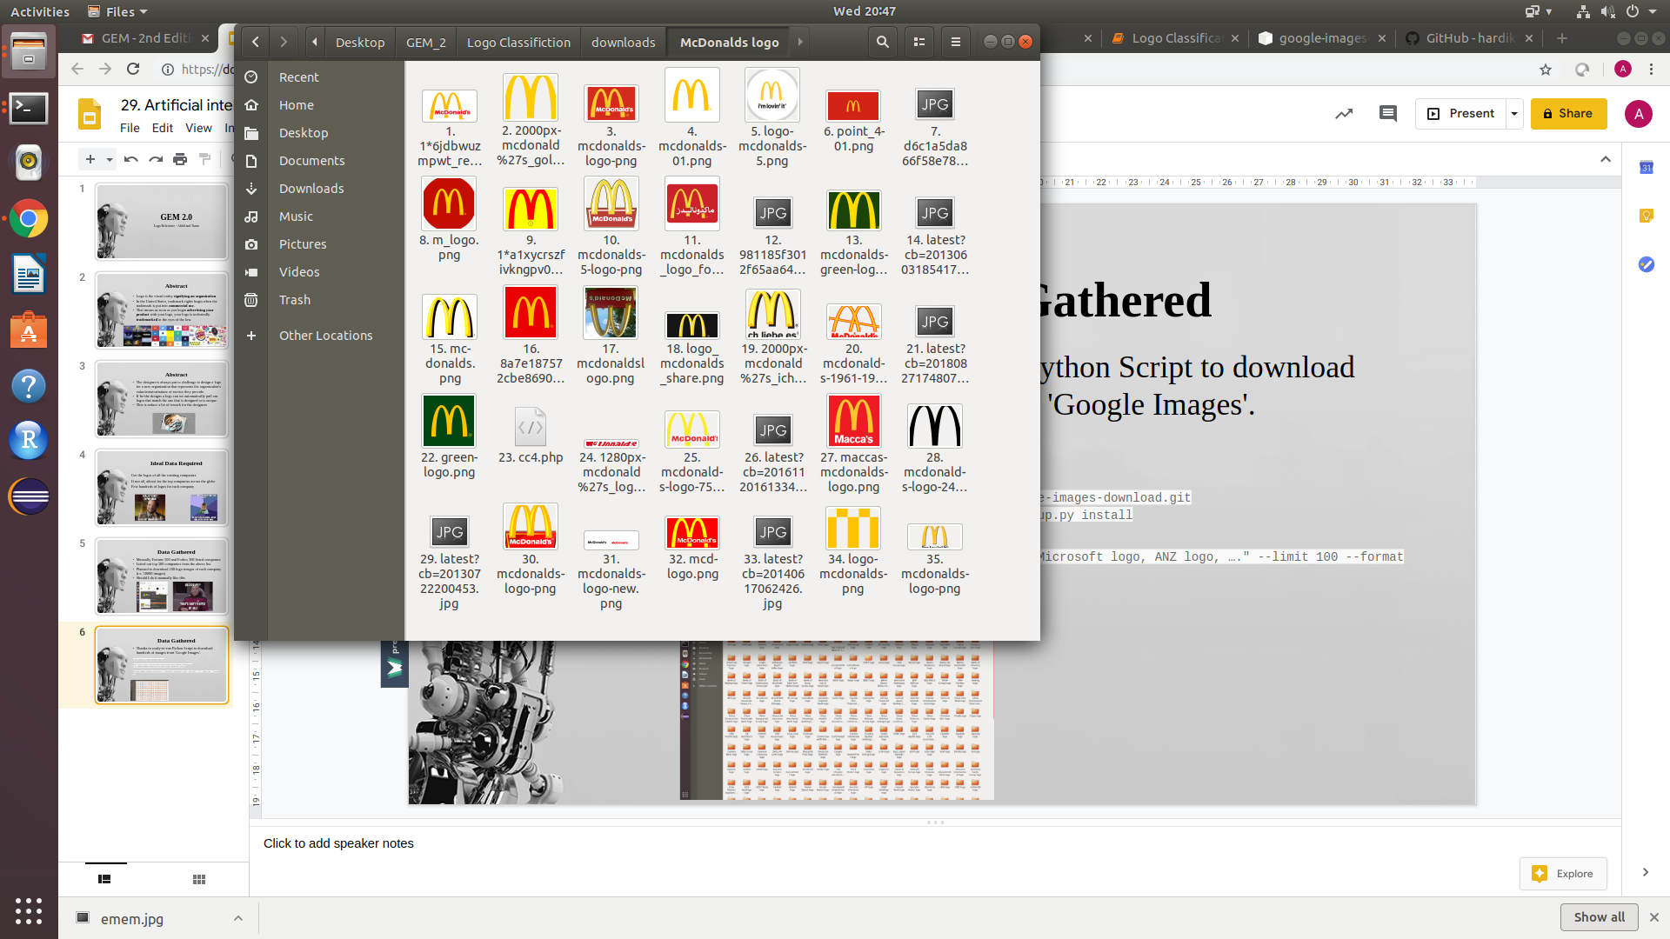
Data Gathered
Thanks to ready-to-run Python Script to download hundreds of images from 'Google Images'.
scraped 100 logo images for each company i.e. 50000 images - has a lot of noise
$ pip install google_images_download
$git clone https://github.com/hardikvasa/google-images-download.git $ cd google-images-download && sudo python setup.py install
$python google-images-download.py --keywords "Microsoft logo, ANZ logo, …." --limit 100 --format png

Slide 9
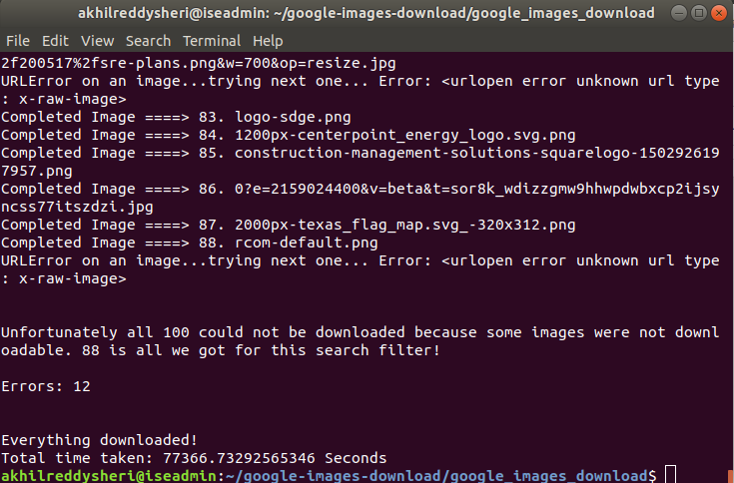
Data Gathered
Marathon!

Slide 10
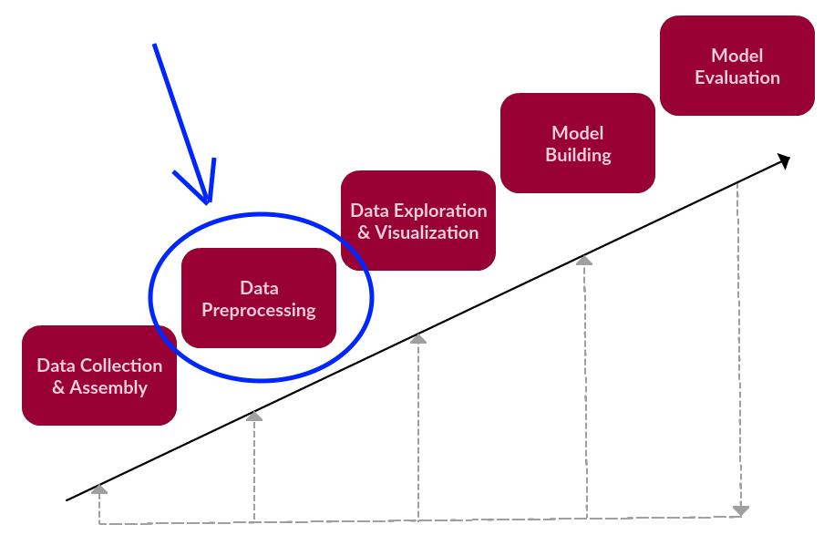
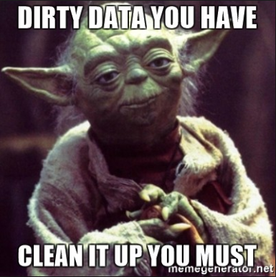
Image Preprocessing

Slide 11
Image Preprocessing
As the images are scraped, there are corrupted images, so, Subsetted 12 images for each brand
Resized all images to size (50,50,3)
Created a numpy array and combined all the train images
Numpy array is of size (no_of_train_images, 50, 50, 3)
Similarly created target variable which is of size (no_of_train_images,)

Slide 12
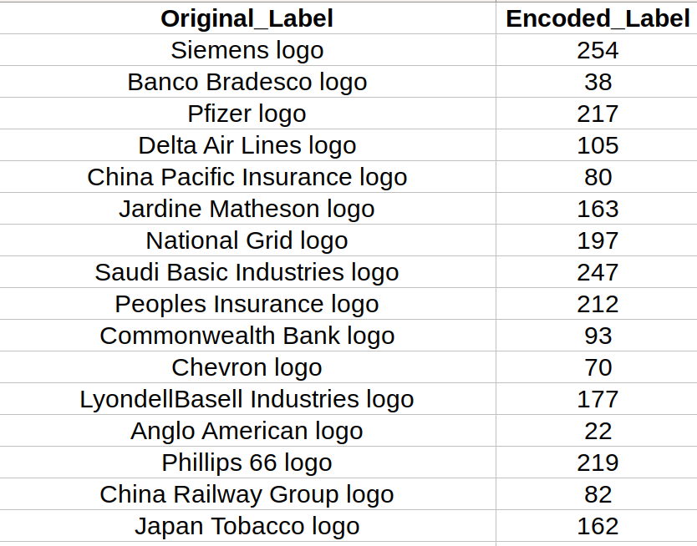
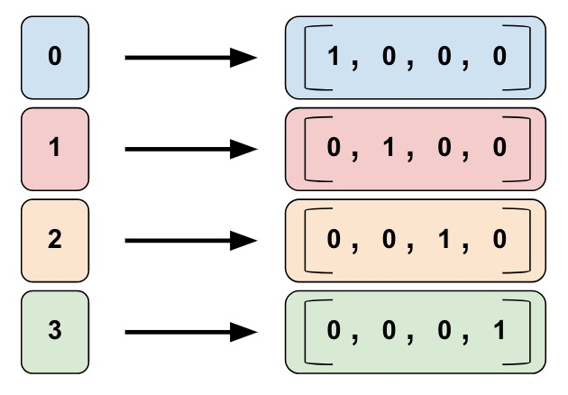
Label Encoding and Categorical Encoding - Target Label
Encoded_Label
TARGET to CNN
Now target variable of size (no_of_train_images, no_of_classes)

Slide 13
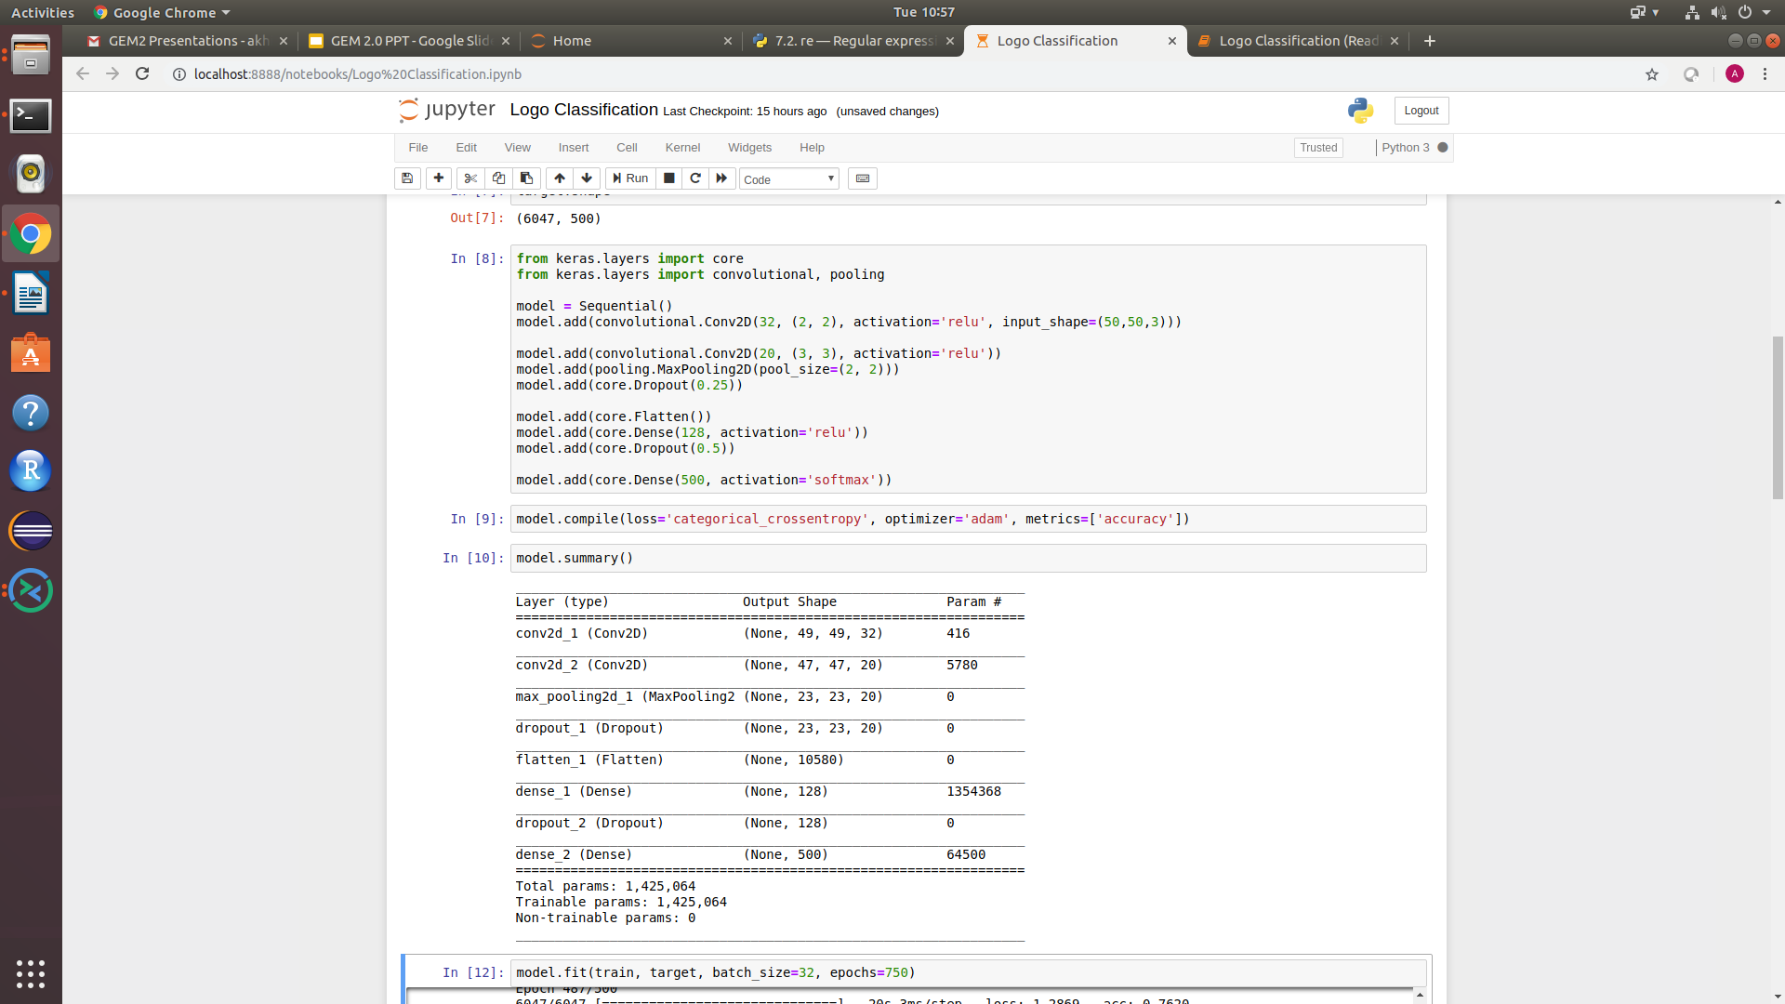
CNN Model

Slide 14
Code Walkthrough

Slide 15
Performance Evaluations
Model 1: CNN with 100 images in each class (Total 500 classes)
3 Convolution Layers, No Dropout
Train - 0.22%
Test - 0.02%
1
Model 2: CNN with 50 images in each class (Total 300 classes)
3 Convolution Layers
Train - 51%
Test - 30%
2
Model 3: CNN with 50 images in each class (Total 500 classes)
3 Convolution Layers
Train - 55%
Test - 35%
3
4
Model 4: CNN with 12 images in each class (Total 500 classes)
2 Convolution Layers, 200 epochs
Train - 61%
Test - 55%
5
Model 5: CNN with 12 images in each class (Total 500 classes)
2 Convolution Layers, 750 epochs
Train - 84%
Test - 75%

Slide 16
The Deployment Phase
Flask (Web Framework)
HTML (creating web pages)
Java Script (For interactive web pages)
Saved Model weights (For predictions/reusing for another application)

Slide 17
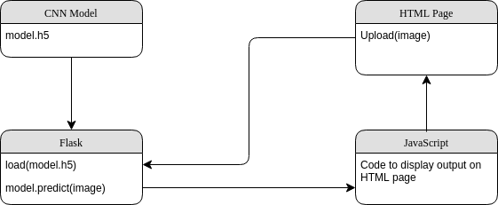
Deployment flow

Slide 18
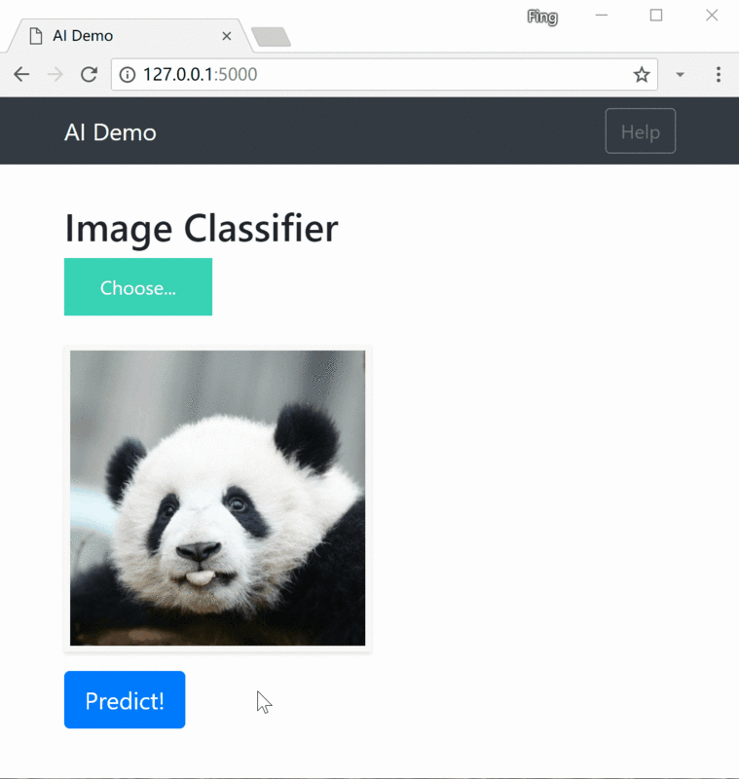
Deployment Example

Slide 19
Deployment Code Walkthrough

Slide 20
Future Scope
Gather more data (more images for each class)
Improving the prediction accuracy by adding more layers
Diverse Applications:
Virtual: API to detect all the logos in a live video/image (opencv)
Physical:
Can attach a camera to the application such that if we draw a logo in a Sheet & click the capture button - it processes the image and implements the same work-flow
On the other hand, we can attach a ‘Digital Graphic Drawing Pad/Tablet’ to the system and draw the logo [which most professionals do], they can send that digital logo to the application and get the results

Slide 21
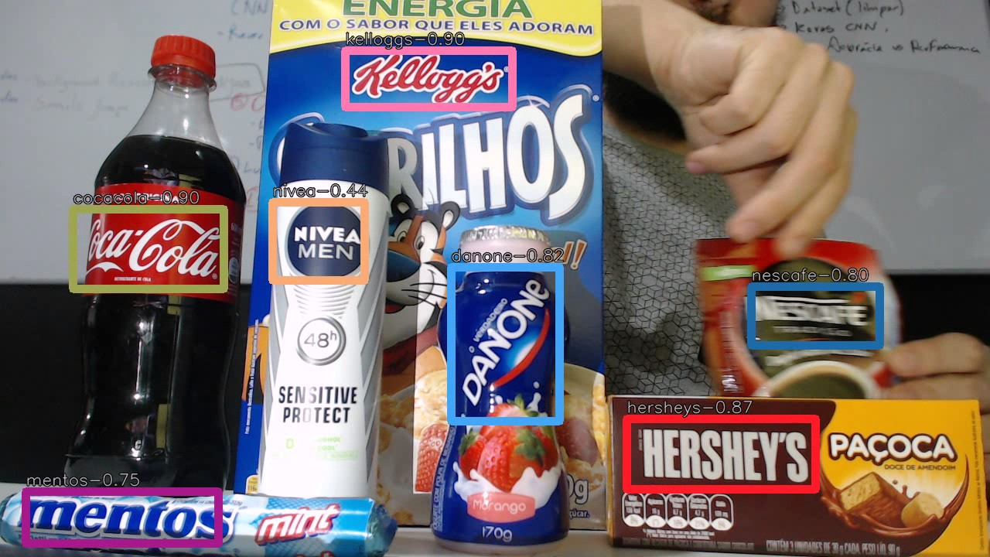
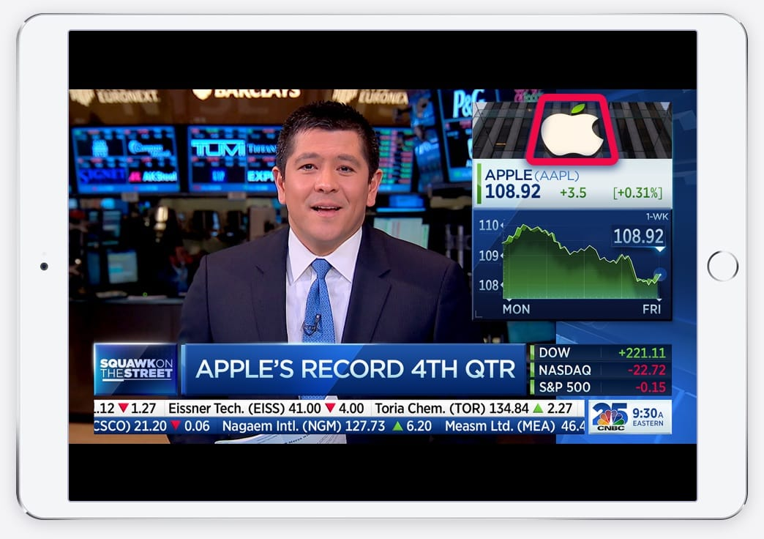
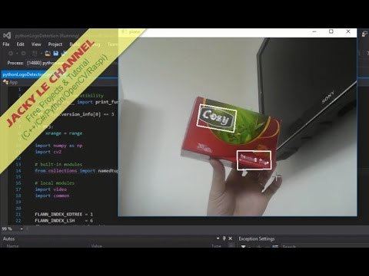
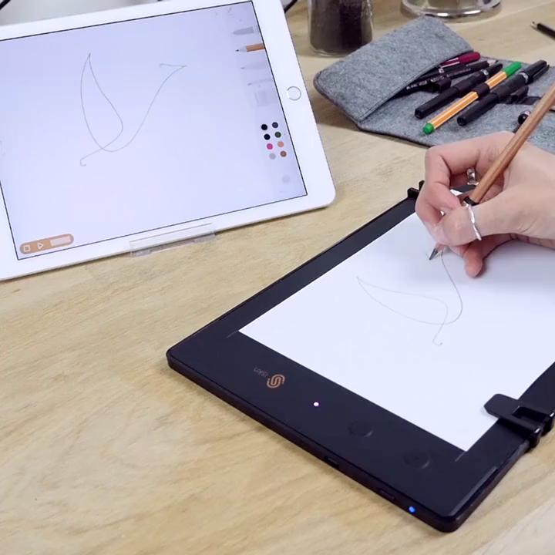
Future Scope

Slide 22
Conclusion
Achieved ~80% Accuracy on 500 classes with 12 images in each class, there is scope of further improvement.
Scope of including more images for each class and increase the number of classes.
Manually remove noise and train on ideal set of images for each class (requires laborious effort)

Slide 23
References
https://github.com/satojkovic/DeepLogo
https://www.upcounsel.com/trademark-infringement-penalties
https://keras.io/
https://github.com/mtobeiyf/keras-flask-deploy-webapp
https://pypi.org/project/google-images-download/1.0.1/
stackoverflow
google

